Slide 1
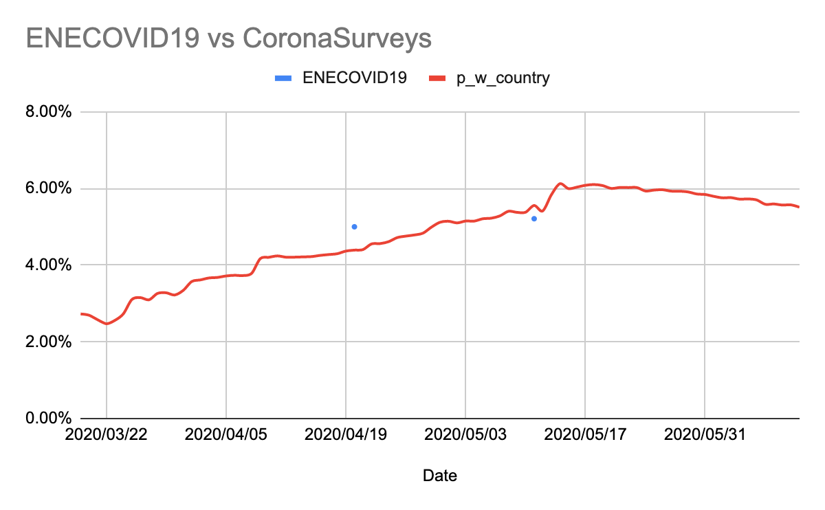
Sensing the World via Surveys
Roughly, how many cases of COVID-19 Spain had?
How is this number evolving over time?
Is there a burst of cases?

Slide 2
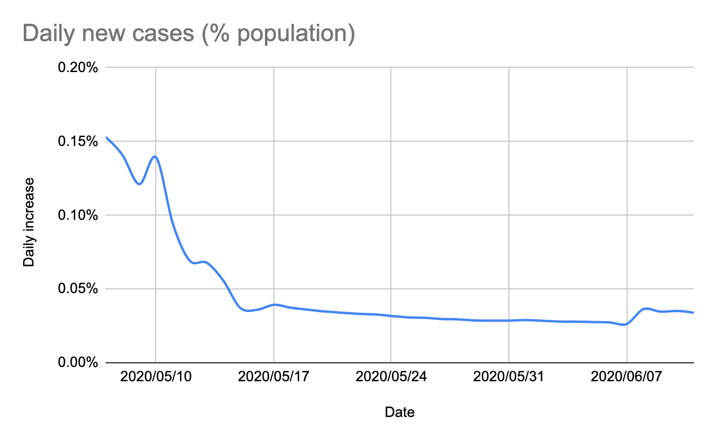
Sensing the World via Surveys
Roughly, how many cases of COVID-19 Spain had?
How is this number evolving over time?
Is there a burst of cases?

Slide 3
Sensing the World via Surveys
Roughly, how many cases of COVID-19 Spain had?
How is this number evolving over time?
Is there a burst of cases?
This estimates have been obtained from ~5000 responses to a survey of 3 questions:
Hay many people do you know personally
How many of them had COVID-19 symptoms
How many developed the symptoms in the latest 7 days
The survey is now open for all countries in ~60 languages
Surveys with indirect reporting are scalable and cheap, and can be used to monitor almost every aspect of society in any country (political, economical, social, demographic, etc.): We can sense the world
Biggest challenge: participation
Apps
Advertisement campaigns
Ambassadors

Slide 4

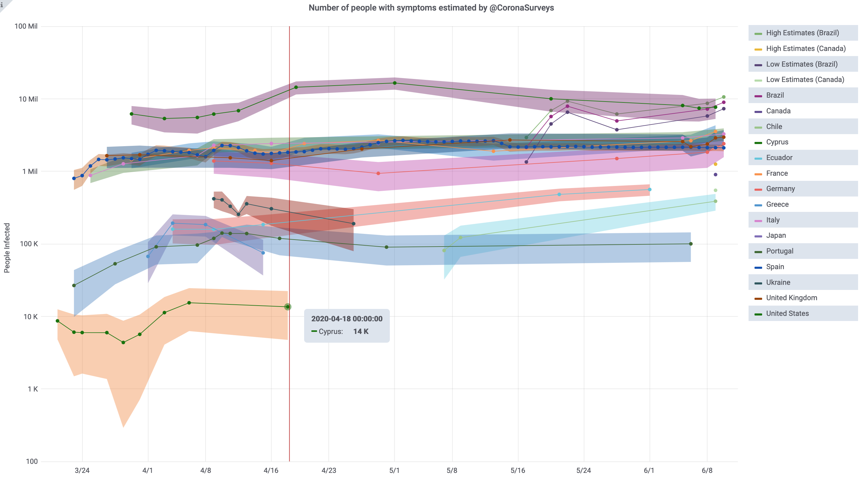
Sensing the World via Surveys

